Slide 1
CS-630 Databases Jan. 13th, 2025 Mondays

Slide 2
Purpose of database
To store data
To provide organizational structure for data
To provide method of querying, creating, accessing, modifying, data
To store data in formats in which we can form relationships
We don’t want data just as lists
Acronym CRUD (Create, Read, Update, Delete)

Slide 3
Problem with Lists: Redundancy
Name | Employee ID | Phone Extension
John | 123 | 2524
John | 123 | 2524
John | 123 | 2524
Liz | 456 | 1129
Liz | 456 | 1129
Carl | 789 | 2716
Carl | 789 | 2716
Carl | 789 | 2716

Slide 4
Problem with Lists: Redundancy
To store data
To provide organizational structure for data
To provide method of querying, creating, accessing, modifying, data
To store data in formats in which we can form relationships
We don’t want data just as lists
Acronym CRUD (Create, Read, Update, Delete)

Slide 5
Problem with Lists: Redundancy
Name | Employee ID | Phone Extension | Project Name | Project ID | Start Date | End Date | Budget
John | 123 | 2524 | DB Upgrade | 101 | 06/01/23 | 06/01/27 | $7,200.00
John | 123 | 2524 | Maintenace | 102 | 06/01/23 | 06/01/27 | $6,300.00
John | 123 | 2524 | Website Design | 103 | 06/01/23 | 06/01/27 | $5,600.00
Liz | 456 | 1129 | Cloud Setup | 110 | 06/01/23 | 06/01/27 | $10,000.00
Liz | 456 | 1129 | DB Upgrade | 111 | 06/01/23 | 06/01/27 | $9,300.00
Carl | 789 | 2716 | Website Design | 120 | 06/01/23 | 06/01/27 | $4,200.00
Carl | 789 | 2716 | Server Setup | 121 | 06/01/23 | 06/01/27 | $12,000.00
Carl | 789 | 2716 | Printer Connections | 122 | 06/01/23 | 06/01/27 | $2,100.00

Slide 6
Problem with Lists: Redundancy
Not equal CRUD (Create, Read, Update, Delete)
Creates:
Readability problems
Update problems
Modification problems
Deletion problems
Insertion problems

Slide 7
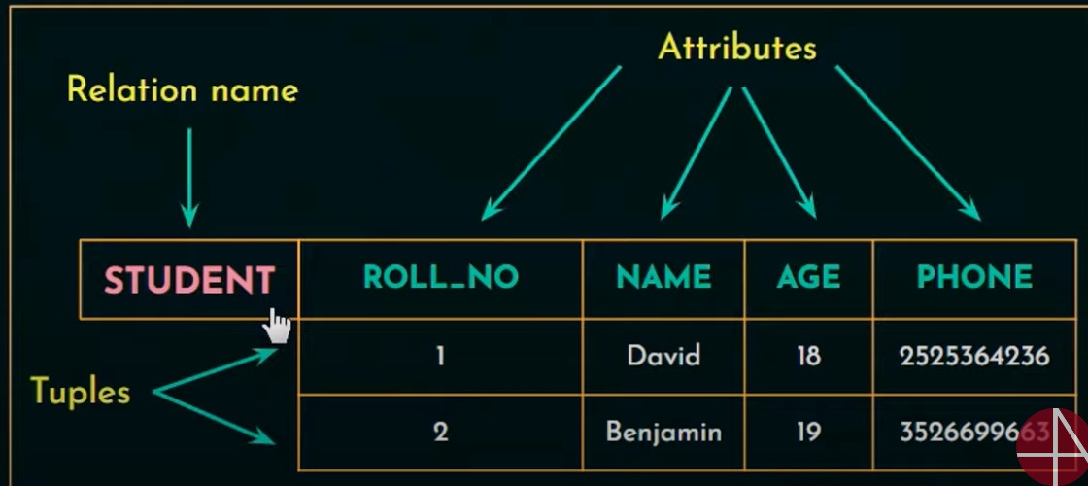
Relational Data Model
Way of structuring data using tables
Which means data in rows and columns
Each row is a record, and each column is a field
Each row is also called a tuple.
Notes:
Student is the table name (or relation name)
Each row in table Student are called tuples
Each column header are fields

Slide 8
Relational Data Model
Domain
Field: Name – string of characters with person’s name
Field: Age – number between (20 to 80)
Data that makes sense for the respective field.

Slide 9
Relational Data Model
Tables:
Data is stored in tables, consisting of rows and columns
Each table has unique name
Each column has unique name within each table
Primary Key:
Unique identifier for a specific row in a table in a database
Used to ensure data integrity, and prevent duplicate entries
Cannot contain null values.

Slide 10
Relational Data Model
Foreign Key:
Field in a database table that is uniquely used to identify row in another table.
Column in one table that refers to primary key of another table.

Slide 11
Integrity Rule
Foreign key is used to enforce referential integrity. This means that data in one table is consistent with data in another table.
Data relationships are very important because they represent data consistency and integrity.

Slide 12
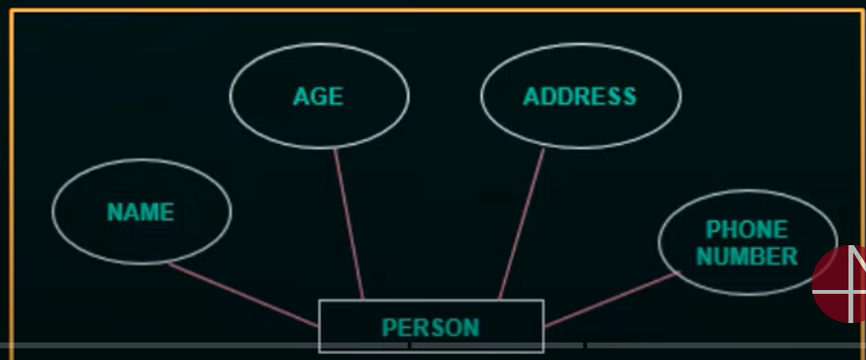
Entity Relationship Modeling
Entities – independent existence
Attributes – properties that describe entities.

Slide 13
Entity Relationship Modeling
Attributes – properties that describe entities.
Attributes – Composite vs Simple
Composite – can be divided further into smaller parts:
Name – First Name, Middle, Last Name
Attributes – Simple
Simple – Age, Salary, Height, Weight (cannot be further expanded)

Slide 14
Entity Relationship Modeling
Single-valued Attributes vs Multivalued Attributes
Age – single valued attribute
Multivalued
Languages, Friends, College Degrees (i.e. Person can know multiple languages, multiple friends, and multiple college degrees)

Slide 15
Entity Relationship Modeling
Derived Attributes vs Stored Attributes
Data that can be derived from another attribute
Ex. Age – (we derive age from date of birth)
Stored Attributes
Date of Birth is stored
Employee start date is stored
Ex. ) Can derive age, and length of employment

Slide 16
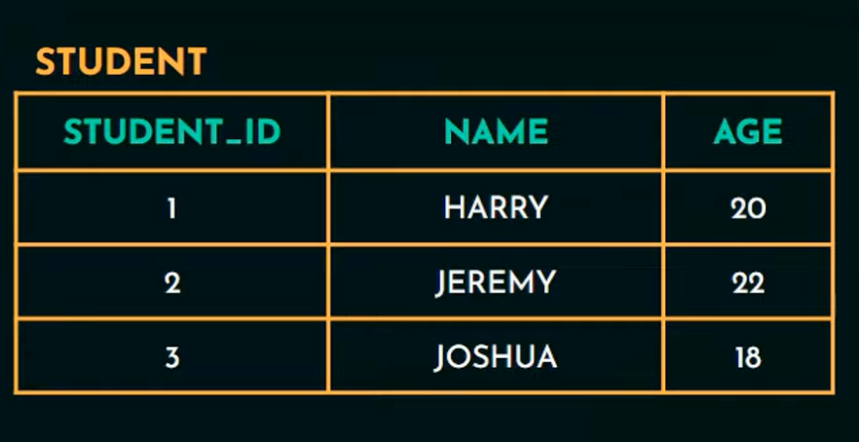
Entity Relationship Modeling
Entity Type:
Collection of entities that have same attributes

Slide 17
Entity Relationship Modeling
Key Attribute
Identifies entity uniquely
Ex) Identify students uniquely with student ID number
Value Set of Attributes
Set of values assigned to an attribute
Ex) Age assigned values range from 20 to 60

Slide 18
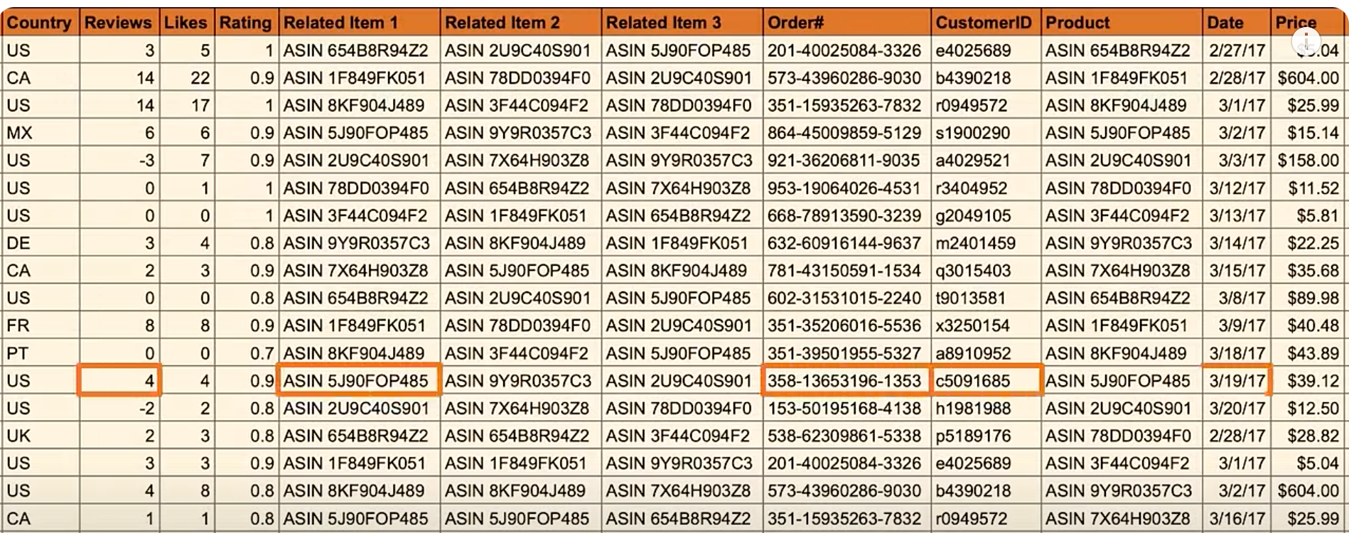
How to Create Entity Relationship Diagram
Think of making Amazon purchase
How does Amazon keep track of so many orders, customers, products?
Creation of database necessary

Slide 19
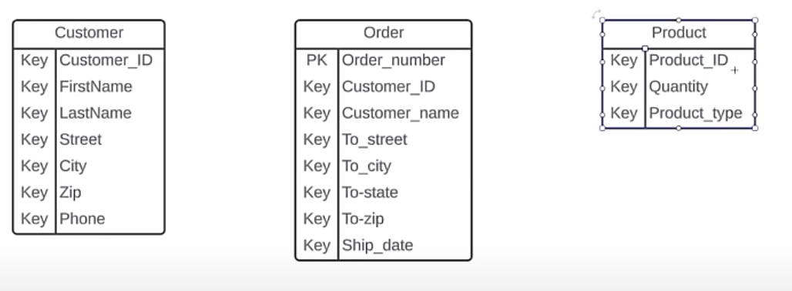
How to Create ERDs
Need to understand how each of these elements interact with one another.
So, we have ERDs (Entity Relationship Diagrams)
To look at how information is related and how it works altogether.
Entity
Person, place, thing that is tracked in the database

Slide 20
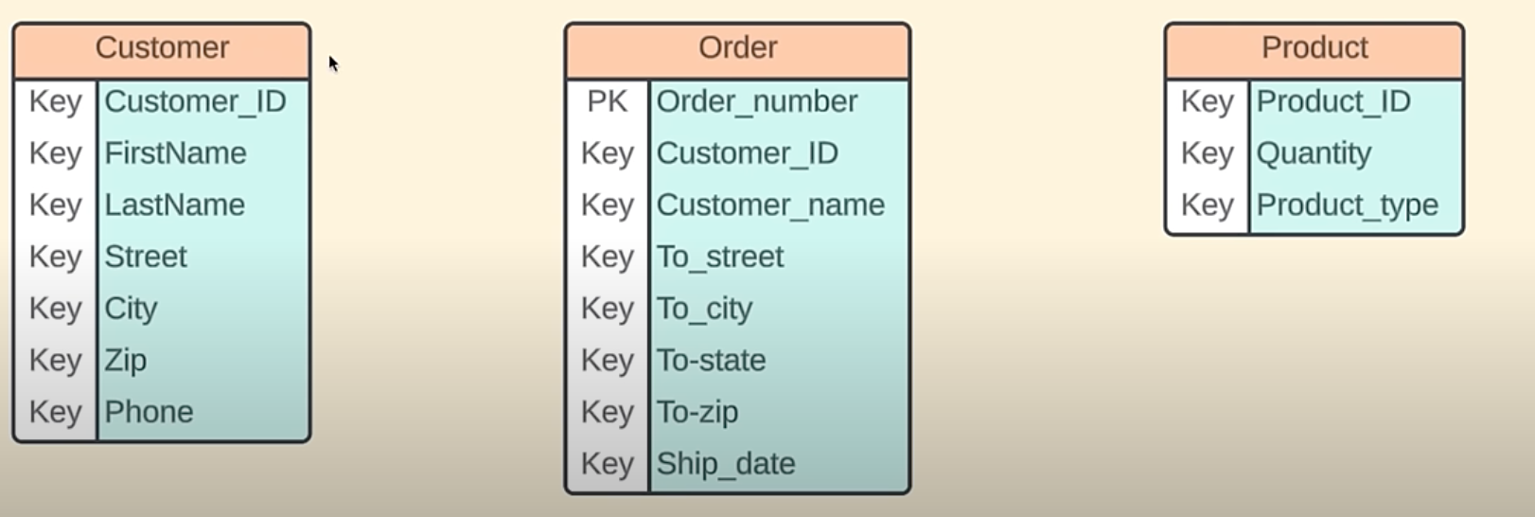
How to Create ERDs
Attributes:
Properties of traits of entities

Slide 21
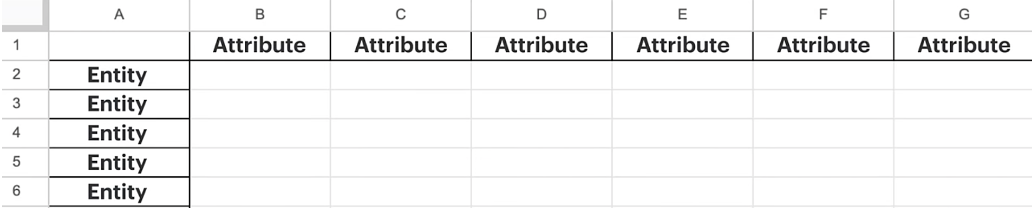
How to Create ERDs

Slide 22
How to Create ERDs
Now we look at relationships
Describe how the entities interact with each other

Slide 23
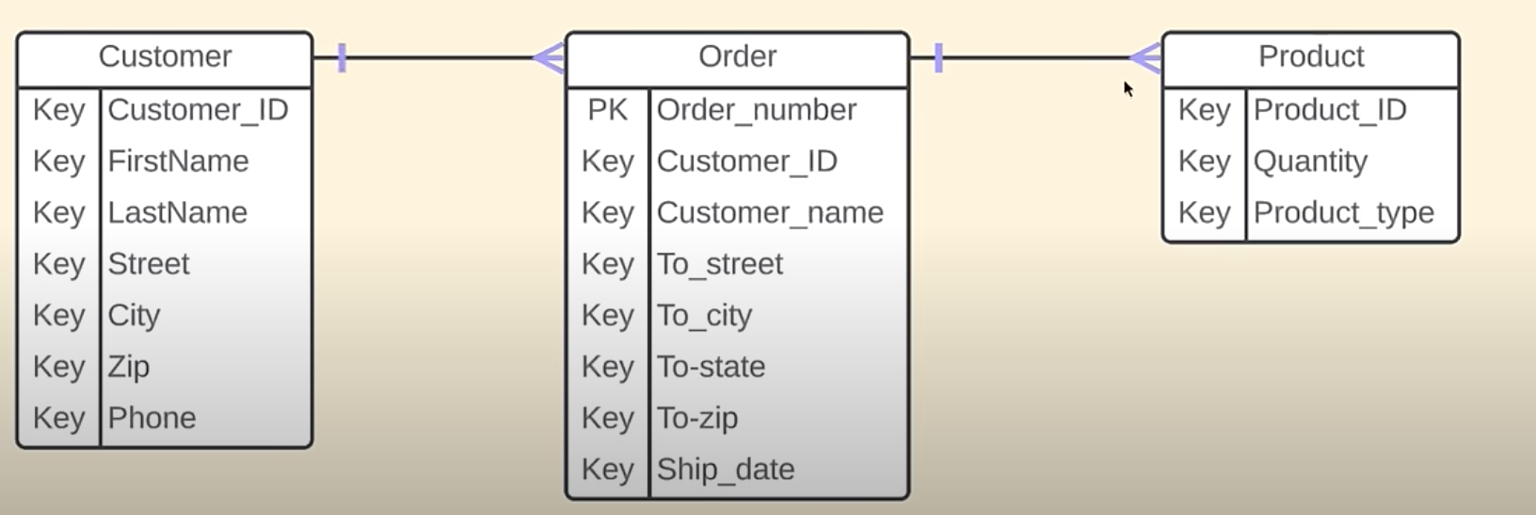
How to Create ERDs
Now we look at relationships
Describe how the entities interact with each other

Slide 24
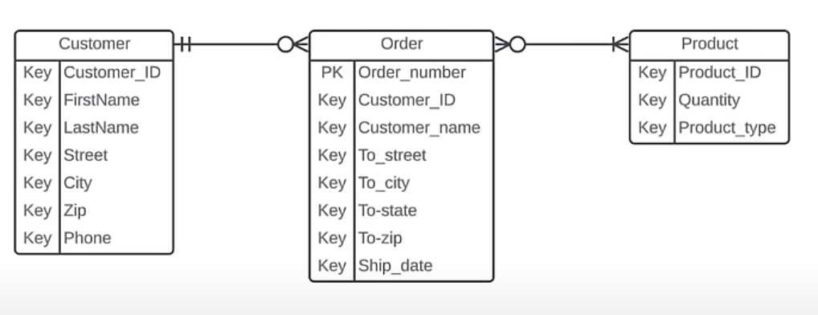
How to Create ERDs
Now we look at relationships
Describe how the entities interact with each other

Slide 25
Quick Recap
Ch.1:
What is database? Purpose of DBMS
Why do we need databases?
Data -> Information -> Knowledge
Unstructured vs Structured Data
Database Terminology (Fields, Records, etc.)
Disadvantage of Manual File / Data Processing vs Using Databases
Do review questions at end of each chapter.

Slide 26
Quick Recap
Ch.2:
Data Models
Why Data Models Important?
Building Blocks
Entity
Attribute
Relationships (1 to Many, Many to Many, 1:1)
Relationships are bidirectional
Data constraints in fields (ie. Age, salary, GPA)

Slide 27
Quick Recap
Ch.2:
What is needed to build good data model?
Understand the business rules.
Business rules are used to define entities, attributes, relationships, constraints.
Customer can have order that includes many products
Customer receipt is generated for one specific customer
Customer address must follow USPS postal format
One customer order cannot exceed 25 items.
How do I find and understand business rules?
Talk to everyone in the organization. Since it is your role to design database as per business rules, and requirements.

Slide 28
Quick Recap
Ch.2:
Customer may generate many invoices
Relationship (1 to Many)
How to identify relationship types? Ask 2 questions
Ex.) Relationship between student and class
How many classes can one student enroll? Many classes
How many students can enroll in one class? Many students
So, relationship between students, and classes is (M:M – many to many)

Slide 29
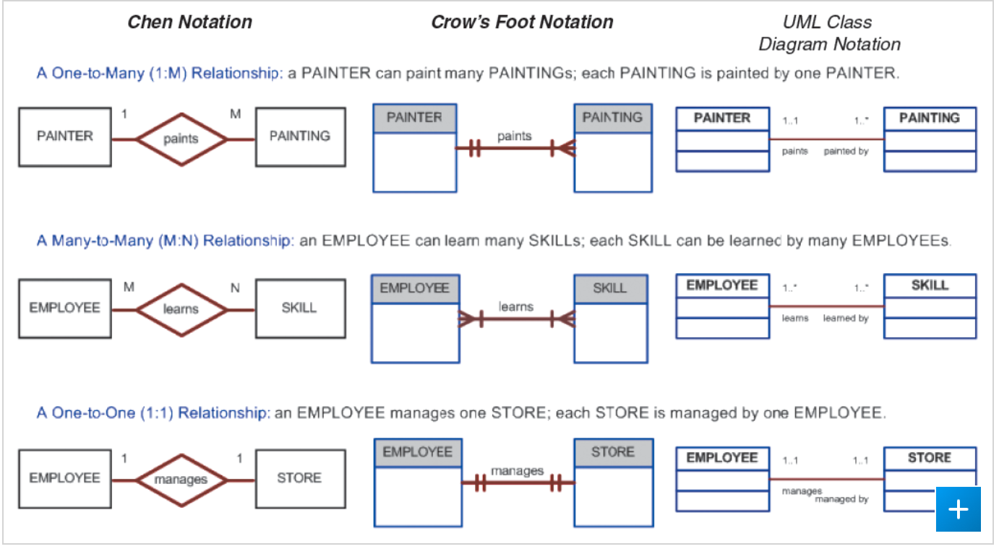
Quick Recap
Ch.2:
ER Data Model
Entity, Attributes, Relationships

Slide 30
Quick Recap
Ch.2:
Review 2-5g : Data Models – A Summary
Provides adv / disadv of various data models
Ch.3:
Integrity Rules – extremely important
Referential Integrity – refers to relationship between tables.
Each table in database must have primary key
Primary key can appear in other tables because of its relationship to data in those tables
When primary key from one table appears in another table its called foreign key
Foreign keys job tables and establish dependencies between tables.

Slide 31
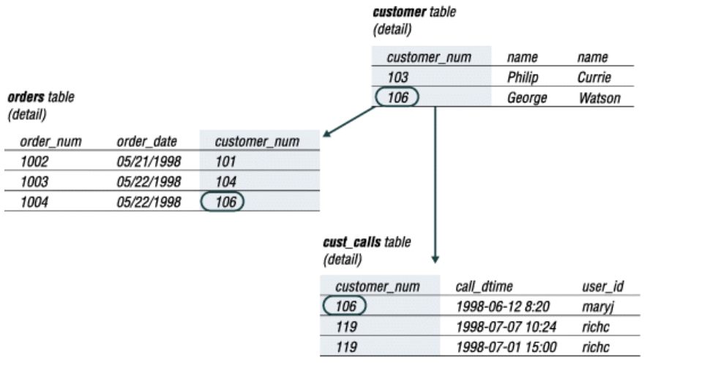
Quick Recap
Referential Integrity Example

Slide 32
Quick Recap
Ch.3: Entity Integrity
Primary key in table cannot be NULL value
All primary key entries must be unique
NOT NULL constraint – no NULL values
UNIQUE constraint – no duplicate values

